Slide 1

Technical Paper Presentation
Track Number: 1B
Paper ID: 1020
Paper Title: Ensemble learning based Deep Learning Architecture for malignancy detection of mediastinal lymph nodes in CT images
Authors: Posina Praneeth (Presenter), Abothula Dhana Lakshmi,
Dr. Hitesh Tekchandani, Dr. Shrish Verma, Dr. Narendra D. Londhe

Slide 2

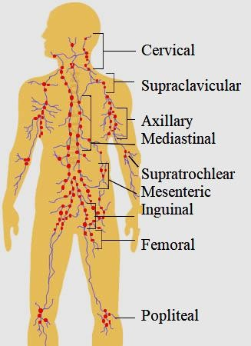
Introduction to Lymphatic System
Lymph nodes (LNs) remove toxins & other unwanted materials from the human body.
The spreading of tumor cells from the primary organ to other organs is called cancer metastasis.
Invasive procedures like biopsy have limitations of pain, anesthesia, nerve or vessel injury, cost, time, and complicated anatomical location.
Medical imaging (like X-ray, USG, CT, and MRI) based diagnosis approaches are non-invasive.
But manual inspection of medical images are time consuming, fatigue, and requires highly expert knowledge.
Fig 1: LNs in Human Body

Slide 3
Related Work
Size-based [1]–[5], CT texture feature-based [6]–[9], and radiomics feature-based [10]–[12] techniques were introduced by researchers.
These algorithms needs huge manual feature selection.
Some researchers have worked on DL approaches for malignancy detection in LNs [13]–[17].

Slide 4
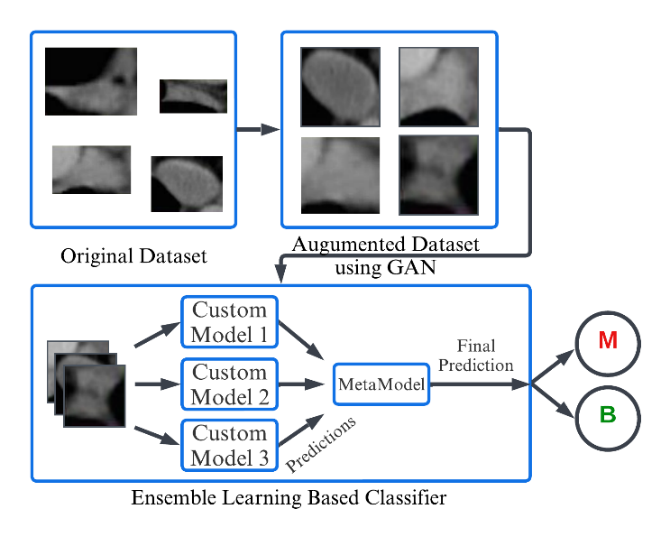
Methodology
Ensemble learning significantly improves machine learning results by blending multiple models, when compared to a single model, this technique produces greater predictive performance.
Weak learners are combined to create a strong learner, which generalises to more accurately predict all the target classes. The final ensembled model is generally named as meta learner.
Fig 2: Workflow of the proposed ensemble learning based approach. “Malignant, M”, “Benign, B”.

Slide 5
Types of Ensemble Learning
In Majority voting, the class label that is predicted most number of times by each individual classifier is considered the final predicted class label for the given task.
A weighted voting based ensemble learning is an improvement to the majority voting in which the weighting of each member's contribution to the final prediction is determined by the individual model's performance.
Stacking is a popular meta-learning approach. This method utilizes a meta-learner to determine which classification models are reliable and which are not.

Slide 6
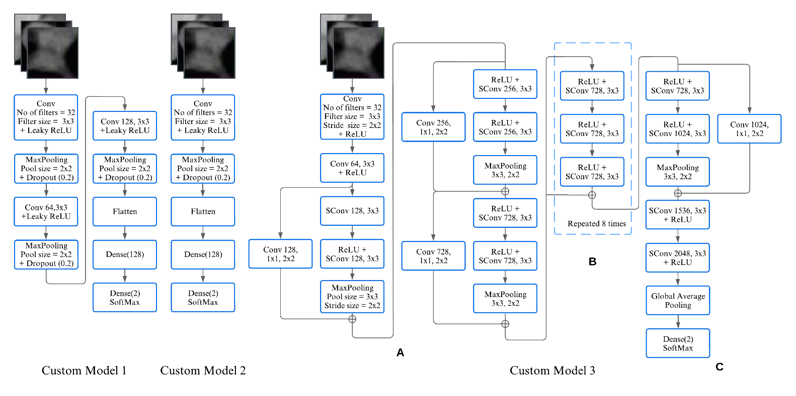
Proposed Individual Ensemble Classifiers
The proposed Custom Model 1 is composed of three sets of convolutional, and maxpooling layers, followed by flatten and fully connected layers. For the proposed model state-of-art Leaky ReLu activation function is utilized. The loss function used is categorical cross-entropy. Further, we have used the state-of-art optimizer Rectified Adam.
The proposed Custom Model 2 is pruned version of model 1 in which one convolutional layer and one maxpooling layer are present followed by flatten and fully connected layers, with same activation function, loss function and optimizer as utilized for custom model 1.
Fig 3: Model architectures of Custom models 1 & 2.

Slide 7
Cntd..
The proposed Custom model 3 is based on XceptionNet [18] concept. This model utilizes the depth-wise separable convolutions (DSConvs).
DSConvs are computationally more efficient alternatives to classical convolutions. The DSConv is significantly and effectively utilized throughout the custom model 3.
In addition, residual or skip connections, are added across the flow of the network.
Fig 4: Model architectures of Custom model 3.

Slide 8
Results
TABLE I: PREDICTION PERFORMANCE OF CUSTOM MODEL1,2,&3 ON EACH FOLD.
Model | Fold | ACC | SEN | SPE | AUC
 |  | (in %)
Custom Model 1 | Fold 1 | 96 | 96.13 | 95.86 | 96
 | Fold 2 | 96.55 | 96.81 | 96.30 | 96.56
 | Fold 3 | 95.67 | 95.45 | 95.86 | 95.66
 | Fold 4 | 96.11 | 97.95 | 94.34 | 96.15
 | Fold 5 | 96 | 96.13 | 95.86 | 96
Custom Model 2 | Fold 1 | 97.22 | 96.59 | 97.82 | 97.20
 | Fold 2 | 97 | 96.81 | 97.17 | 96.99
 | Fold 3 | 97.11 | 98.63 | 95.65 | 97.14
 | Fold 4 | 97.33 | 98.40 | 96.30 | 97.35
 | Fold 5 | 97.22 | 96.81 | 97.60 | 97.21
Custom Model 3 | Fold 1 | 97.55 | 97.72 | 97.39 | 97.55
 | Fold 2 | 96.22 | 96.59 | 95.86 | 96.23
 | Fold 3 | 97.33 | 96.36 | 98.26 | 97.31
 | Fold 4 | 98 | 97.27 | 98.69 | 97.98
 | Fold 5 | 97.88 | 97.72 | 98.04 | 97.88
The proposed custom models 1, 2, and 3 attain an average accuracy of 96.06%, 97.16%, and 97.4% respectively.
It is also observable from the table 1 that less complex models namely model 1 and 2 performed equally well with sophisticated model 3 however model 3 slightly does better than other two models.

Slide 9
TABLE II: EVALUATION PARAMETERS OF MAJORITY VOTING, WEIGHTED VOTING, AND STACKING ENSEMBLES.
Cntd..
Ensemble Method | ACC | SEN | SPE | AUC
 | (in %)
Majority Voting | 97.95 | 98 | 97.91 | 97.95
Weighted Voting | 98.06 | 98 | 98.13 | 98.06
Stacking | 98.56 | 99.09 | 98.04 | 98.56
The table infers that majority voting provided equal weightage to all the models does not extract the full potential of high performing models. Whereas, weighted voting with more weightage to significantly high performing models was effective up to a certain extent.
However, multi-level training of stacking helped in producing better performance by the proposed approach.
Table 3 compares the performance evaluation metrics from related works. The proposed approach achieves a significant improvement of 3.56% in ACC, 5.09% in SEN, 1.04% in SPE, and 3.56% in AUC, as shown in Table.
TABLE III: SUMMARY OF PERFORMANCE EVALUATION METRICS OBTAINED FROM RELATED WORKS.
Authors | ACC | SEN | SPE | AUC
 | (in %)
Michael et al. [7] | - | 53 | 97 | 83
Hamid [6] | 71 | 81 | 80 | 87
Hongkai et al. [16] | 86 | 84 | 88 | 91
Pham et al. [8] | 70 | 75 | 90 | 89
Pham et al. [11] | - | 68.01 | 73.35 | 75
Pham et al. (raw images) [17] | 87.07 | 90.42 | 83.96 | -
Hitesh et al. [15] | 63.14 | 71.03 | 55.69 | 63
Hitesh et al. [13] | 90 | 91 | 90 | 90
Hitesh et al. [14] | 95 | 94 | 97 | 95
Proposed Approach | 98.56 | 99.09 | 98.04 | 98.56

Slide 10
References
[1] J. M. Seely, J. R. Mayo, R. R. Miller, and N. L. Müller, “T1 lung cancer: prevalence of mediastinal nodal metastases and diagnostic accuracy of CT.,” Radiology, vol. 186, no. 1, pp. 129–132, Jan. 1993, doi: 10.1148/radiology.186.1.8416552.
[2] H. Libshitz and R. McKenna, “Mediastinal lymph node size in lung cancer,” American Journal of Roentgenology, vol. 143, no. 4, pp. 715–718, Oct. 1984, doi: 10.2214/ajr.143.4.715.
[3] H. C. Steinert et al., “Non-small cell lung cancer: nodal staging with FDG PET versus CT with correlative lymph node mapping and sampling.,” Radiology, vol. 202, no. 2, pp. 441–446, Feb. 1997, doi: 10.1148/radiology.202.2.9015071.
[4] D. W. von Haag, D. M. Follette, P. F. Roberts, D. Shelton, L. D. Segel, and T. M. Taylor, “Advantages of Positron Emission Tomography over Computed Tomography in Mediastinal Staging of Non-Small Cell Lung Cancer,” Journal of Surgical Research, vol. 103, no. 2, pp. 160–164, Apr. 2002, doi: 10.1006/jsre.2002.6354.
[5] L. K. Toney and H. J. Vesselle, “Neural Networks for Nodal Staging of Non–Small Cell Lung Cancer with FDG PET and CT: Importance of Combining Uptake Values and Sizes of Nodes and Primary Tumor,” Radiology, vol. 270, no. 1, pp. 91–98, Jan. 2014, doi: 10.1148/radiol.13122427.
[6] H. Bayanati et al., “Quantitative CT texture and shape analysis: Can it differentiate benign and malignant mediastinal lymph nodes in patients with primary lung cancer?,” European Radiology, vol. 25, no. 2, pp. 480–487, 2014, doi: 10.1007/s00330-014-3420-6.
[7] M. B. Andersen, S. W. Harders, B. Ganeshan, J. Thygesen, H. H. T. Madsen, and F. Rasmussen, “CT texture analysis can help differentiate between malignant and benign lymph nodes in the mediastinum in patients suspected for lung cancer,” Acta Radiologica, vol. 57, no. 6, pp. 669–676, 2016, doi: 10.1177/0284185115598808.
[8] T. D. Pham, Y. Watanabe, M. Higuchi, and H. Suzuki, “Texture Analysis and Synthesis of Malignant and Benign Mediastinal Lymph Nodes in Patients with Lung Cancer on Computed Tomography,” Sci Rep, vol. 7, no. 1, Art. no. 1, Feb. 2017, doi: 10.1038/srep43209.

Slide 11
References
[9] X. Gao et al., “The method and efficacy of support vector machine classifiers based on texture features and multi-resolution histogram from 18F-FDG PET-CT images for the evaluation of mediastinal lymph nodes in patients with lung cancer,” European Journal of Radiology, vol. 84, no. 2, pp. 312–317, Feb. 2015, doi: 10.1016/j.ejrad.2014.11.006.
[10] X. Yang et al., “A new approach to predict lymph node metastasis in solid lung adenocarcinoma: a radiomics nomogram,” J Thorac Dis, vol. 10, no. Suppl 7, pp. S807–S819, Apr. 2018, doi: 10.21037/jtd.2018.03.126.
[11] T. D. Pham, “Complementary features for radiomic analysis of malignant and benign mediastinal lymph nodes,” in Proceedings - International Conference on Image Processing, ICIP, 2018, vol. 2017-Septe, no. 4, pp. 3849–3853. doi: 10.1109/ICIP.2017.8297003.
[12] Y. Zhong, M. Yuan, T. Zhang, Y.-D. Zhang, H. Li, and T.-F. Yu, “Radiomics Approach to Prediction of Occult Mediastinal Lymph Node Metastasis of Lung Adenocarcinoma,” American Journal of Roentgenology, vol. 211, no. 1, pp. 109–113, Jul. 2018, doi: 10.2214/AJR.17.19074.
[13] H. Tekchandani, S. Verma, and N. D. Londhe, “Mediastinal lymph node malignancy detection in computed tomography images using fully convolutional network,” Biocybernetics and Biomedical Engineering, vol. 40, no. 1, pp. 187–199, Jan. 2020, doi: 10.1016/j.bbe.2019.05.002.
[14] H. Tekchandani, S. Verma, and N. Londhe, “Performance improvement of mediastinal lymph node severity detection using GAN and Inception network,” Computer Methods and Programs in Biomedicine, vol. 194, p. 105478, Oct. 2020, doi: 10.1016/j.cmpb.2020.105478.
[15] H. Tekchandani, S. Verma, and N. D. Londhe, “Severity Assessment of Lymph Nodes in CT Images using Deep Learning Paradigm,” in International Conference on Computing Methodologies and Communication, 2018, pp. 686–691.
[16] H. Wang et al., “Comparison of machine learning methods for classifying mediastinal lymph node metastasis of non-small cell lung cancer from 18 F-FDG PET/CT images,” EJNMMI research, vol. 7, no. 1, p. 11, 2017.
[17] T. D. Pham, “From Raw Pixels to Recurrence Image for Deep Learning of Benign and Malignant Mediastinal Lymph Nodes on Computed Tomography,” IEEE Access, 2021, doi: 10.1109/ACCESS.2021.3094577.
[18] F. Chollet, “Xception: Deep Learning with Depthwise Separable Convolutions.” arXiv, Apr. 04, 2017. doi: 10.48550/arXiv.1610.02357.

Slide 12
Thank You

